Slide 1
Introduction to Data Science with Python
Week 01: Introduction

Slide 2
Outlines
Definition,
Scope of Data Science,
Softwares required for Data Science,
Introduction of Python.

Slide 3
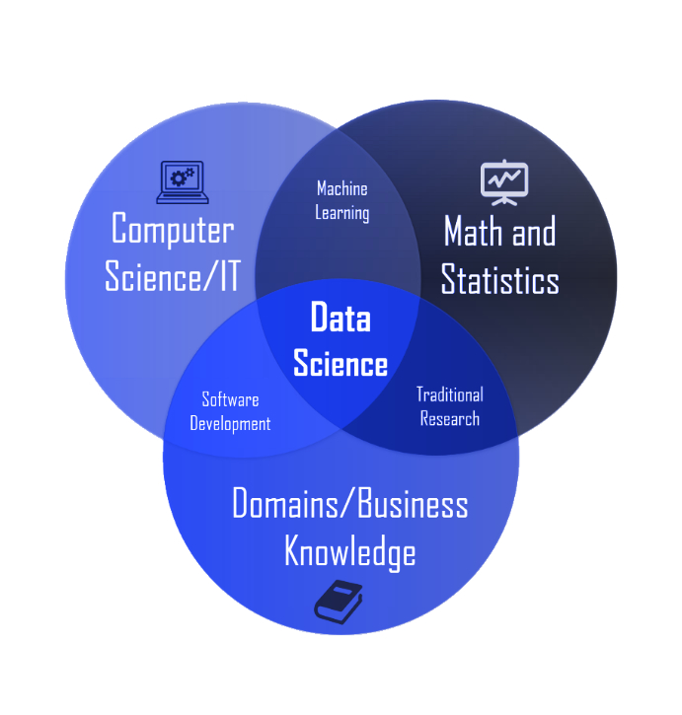
What is data science?
.
.

Slide 4
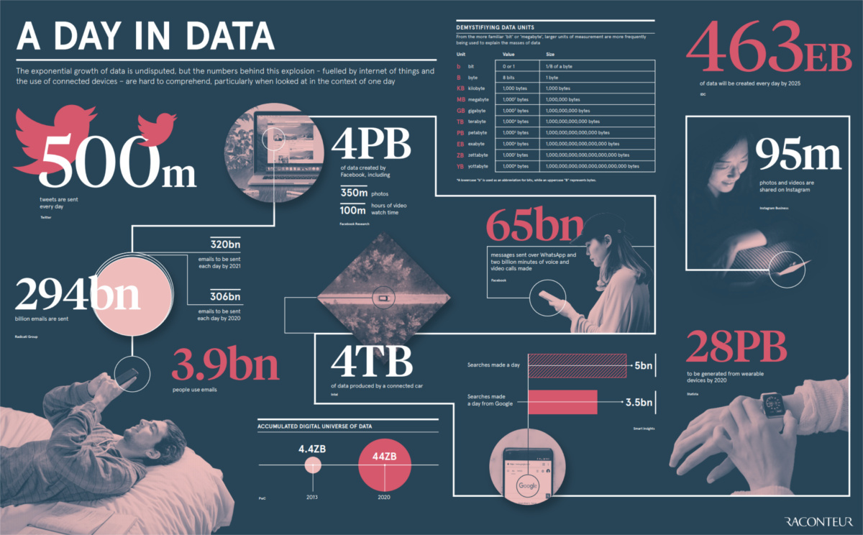
Where is Data?
.

Slide 5
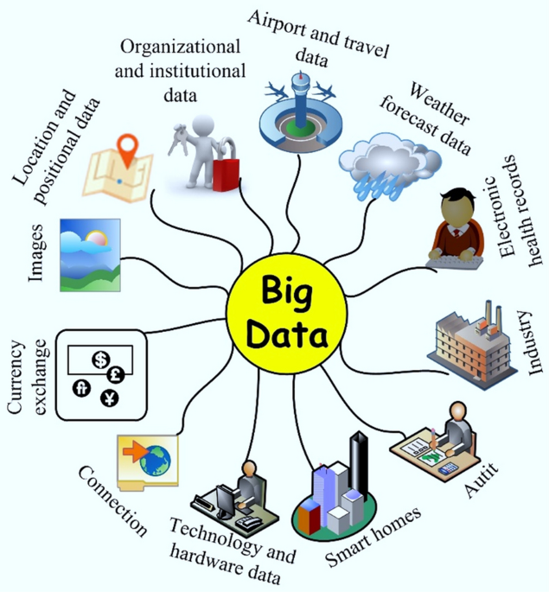
Countless Sources of Data

Slide 6
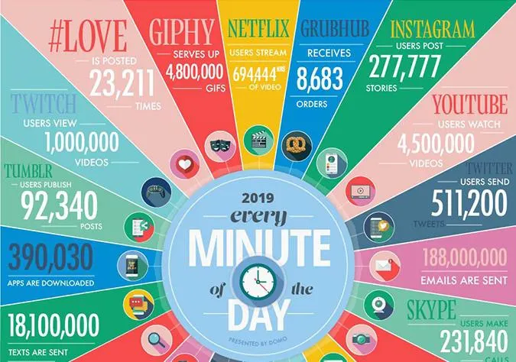
Different Form of Data
.

Slide 7
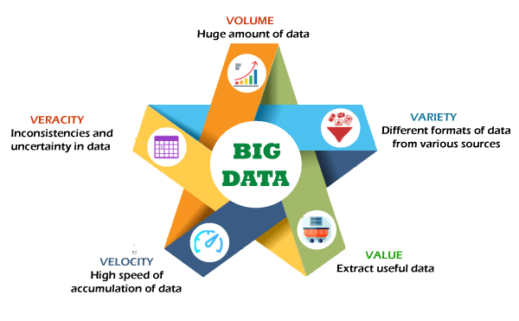
Big Data
.

Slide 8
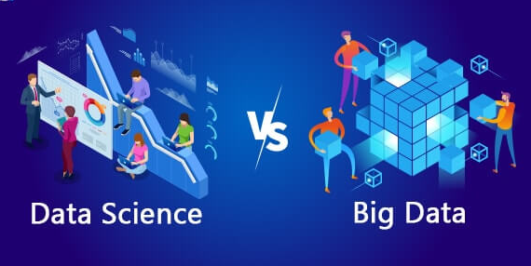
Why Data Science?
.

Slide 9
Data Science: Definition
Data science is the study of data to extract meaningful insights for different domains.
It is a multidisciplinary approach that combines principles and practices from the fields of mathematics, statistics, artificial intelligence, and computer engineering to analyze large amounts of data.
Data science can help organizations understand their environments, analyze existing issues, and reveal previously hidden opportunities.

Slide 10
Data Sources ?
the vast quantity of data available from massively varied sources:
from log files,
email,
social media,
sales data,
patient information files,
sports performance data,
sensor data,
security cameras, and so on.
At the same time that there is more data available than ever, we have the computing power needed to make a useful analysis and reveal new knowledge.

Slide 11
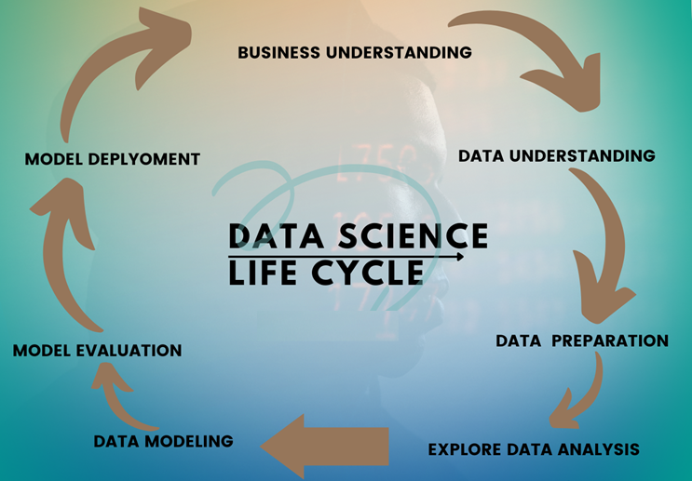
Data Science Process Life Cycle

Slide 12
Steps of Data Science Process
Problem Definition: Clearly defining the problem and identifying the goal of the analysis.
Data Collection: Gathering and acquiring data from various sources, including data cleaning and preparation.
Data Exploration: Exploring the data to gain insights and identify trends, patterns, and relationships.
Data Modeling: Building mathematical models and algorithms to solve problems and make predictions.
Evaluation: Evaluating the model’s performance and accuracy using appropriate metrics.
Deployment: Deploying the model in a production environment to make predictions or automate decision-making processes.
Monitoring and Maintenance: Monitoring the model’s performance over time and making updates as needed to improve accuracy.

Slide 13
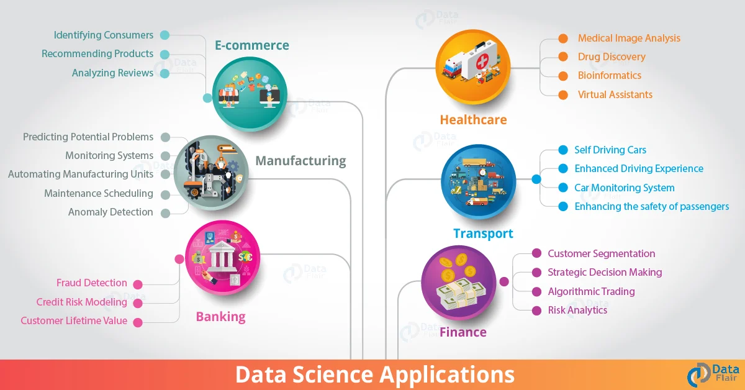
Applications of Data Science
.

Slide 14
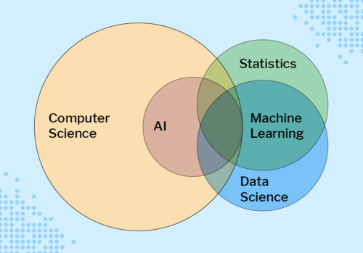
.

Slide 15
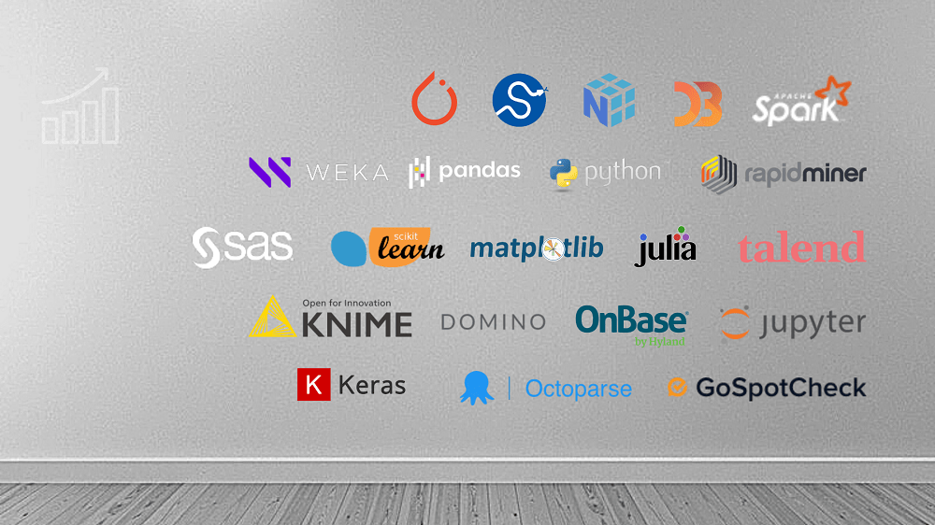
Data Science Tools
.

Slide 16
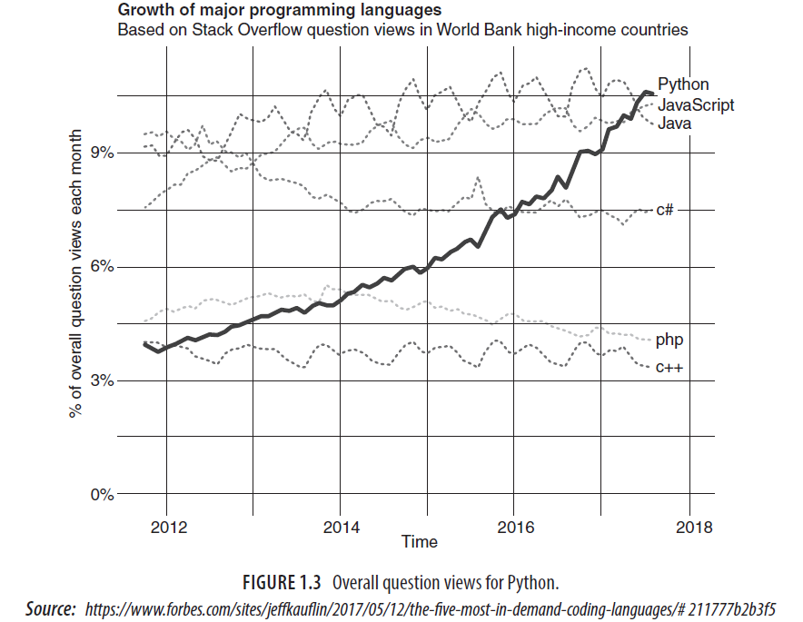
Why Python?
.

Slide 17
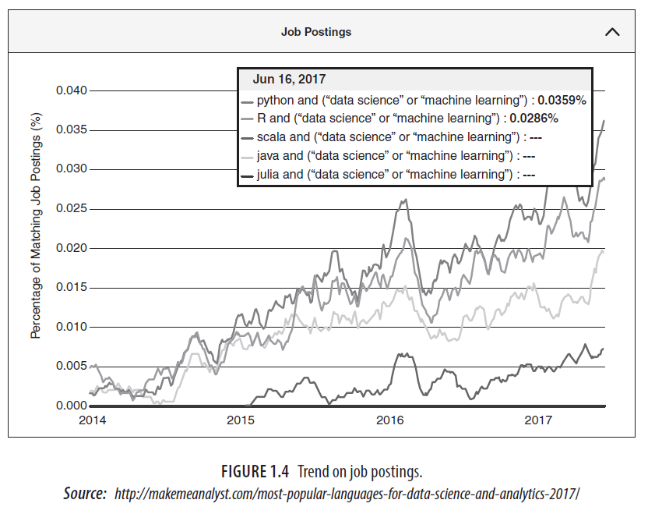
.

Slide 18
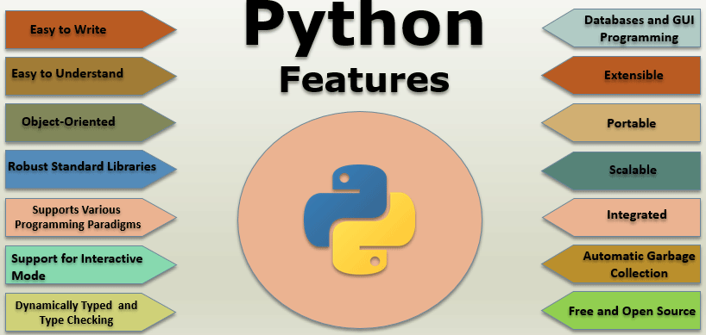
Features of Python
.

Slide 19
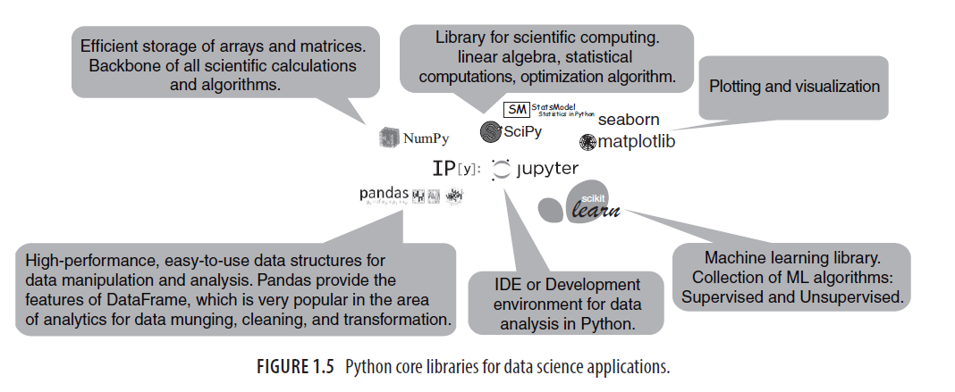
.

Slide 20
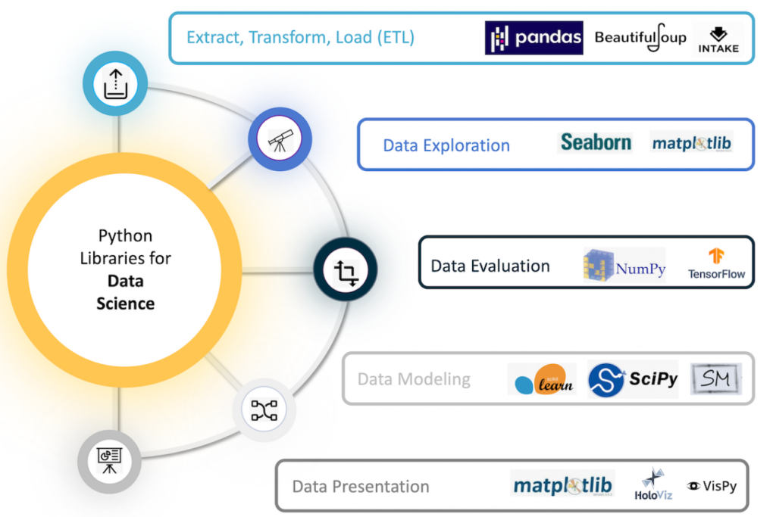
Python for Data Science
.

Slide 21
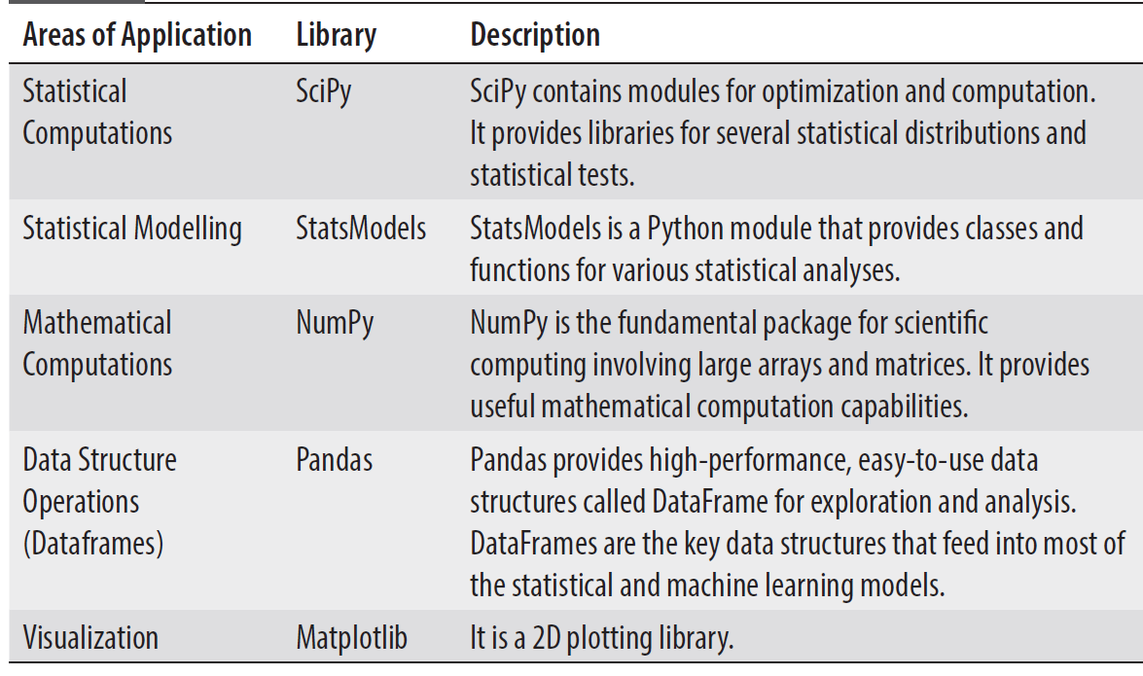
.

Slide 22
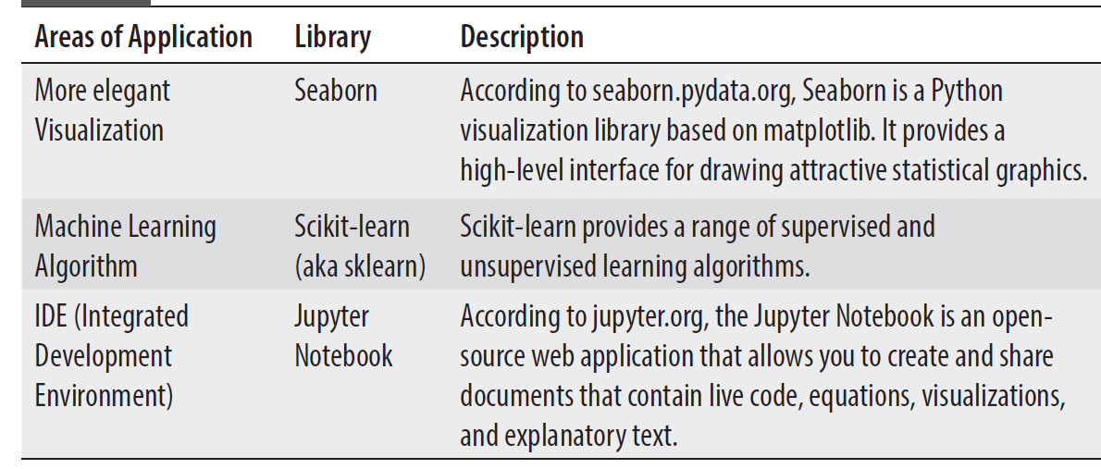
.

Slide 23

.

Slide 24
Getting Started with Anaconda Platform
Anaconda provides a Python environment that has all libraries and tools required for analysis preloaded in it.
Anaconda is a free software and it also offers free community support.
The Anaconda distribution simplifies the installation process by including almost everything we need for working on data science tasks.
It contains the core Python language, as well as all the essential libraries including NumPy, Pandas, SciPy, Matplotlib, sklearn, and Jupyter notebook.
It has distributions for all Operating Systems (OS) environments (e.g. Windows, MAC, and Linux).

Slide 25
Step 1: Go to Anaconda Site
https://www.anaconda.com/distribution/
Step 2: Download Anaconda Installer for your Environment
Step 3: Install Anaconda
Step 4: Start Jupyter Notebook
Step 5: Create a New Python Program
Step 6: Rename the Program
Step 7: Write and Execute Code
Step 8: Basic Commands for Working with Jupyter Notebook

Slide 26
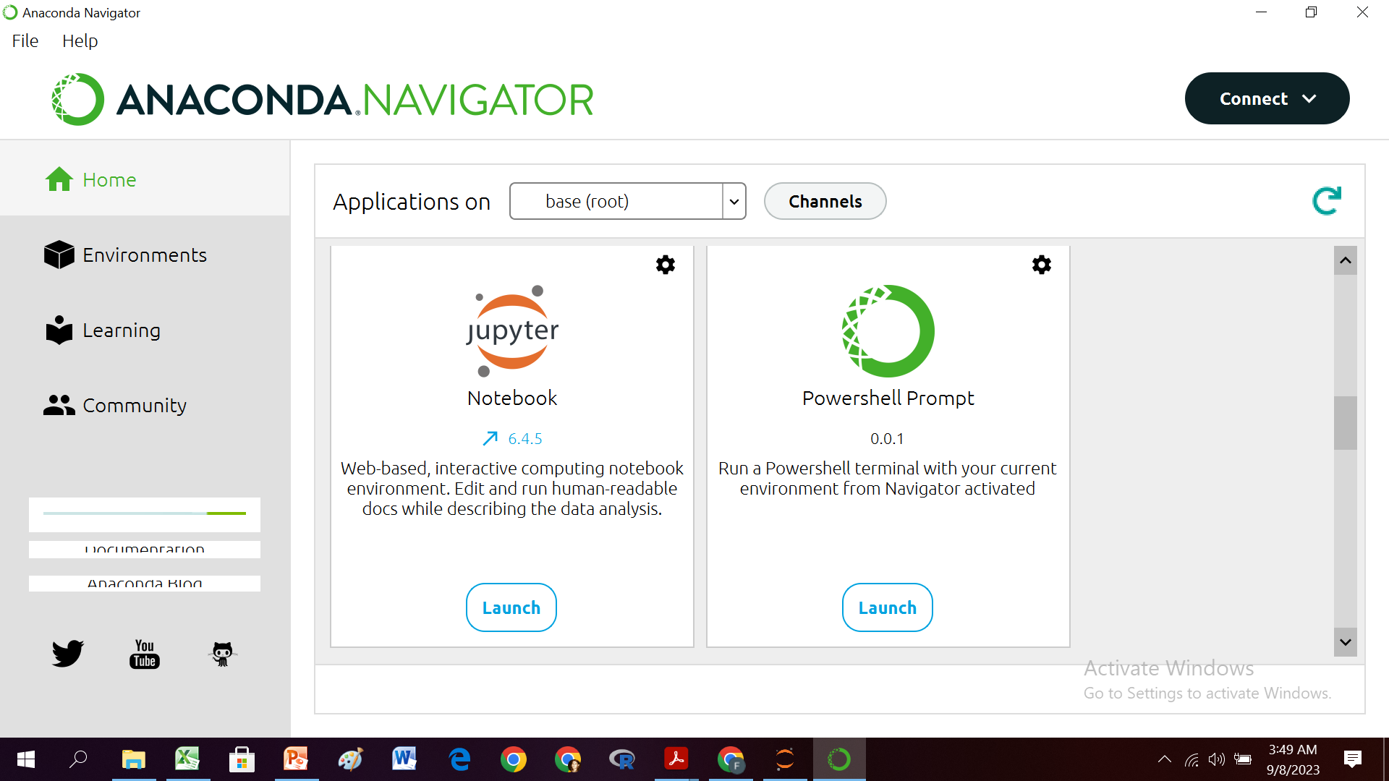
Anaconda Navigator
.

Slide 27
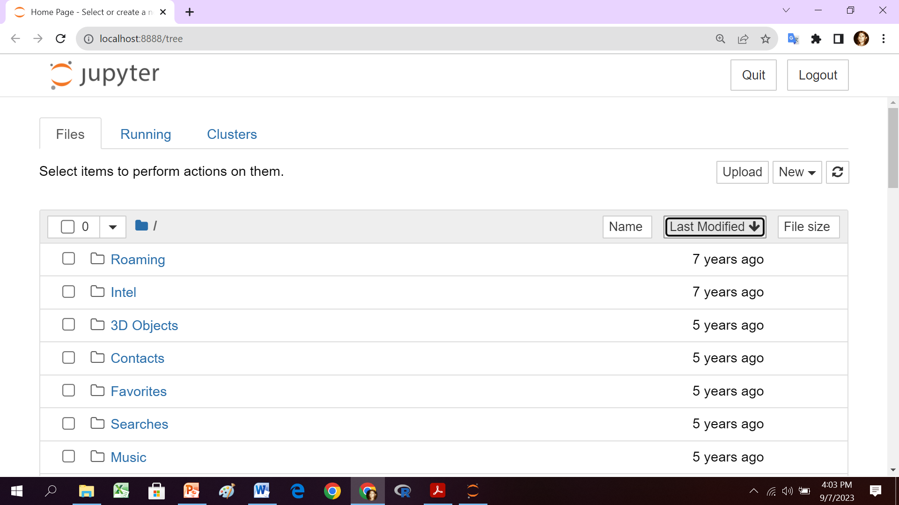
Jupyter Notebook Homepage
.

Slide 28
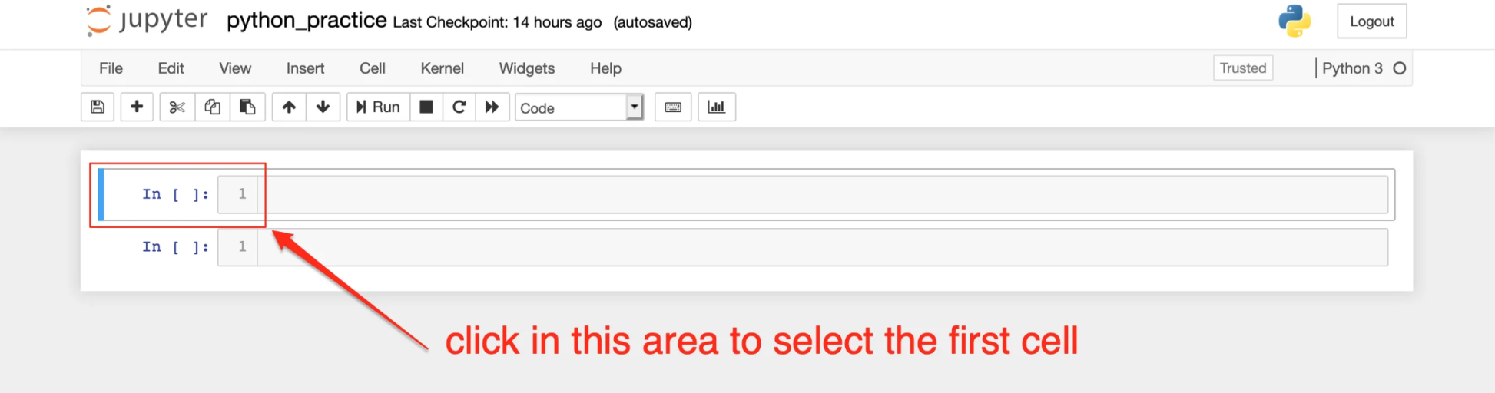
Writing Codes in Jupyter Notebook
.

Slide 29
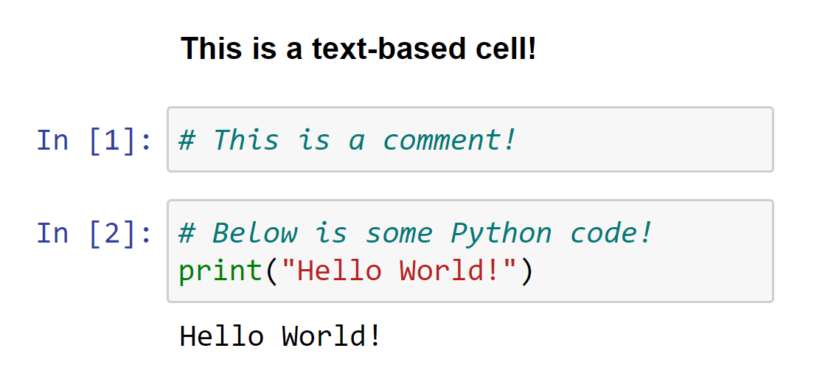
Your First Program in Python!
.

Slide 30
Basic Data Types in Python
Integer (int)
Real (float)
String (str)
Boolean (bool)

Slide 31

.

Slide 32
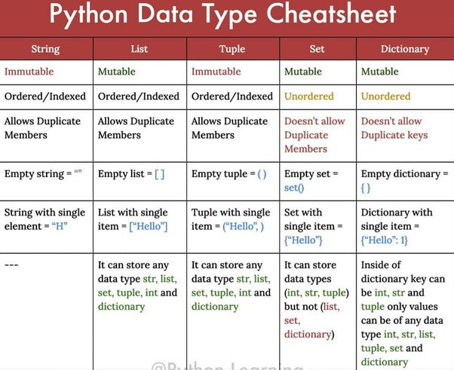
.

Slide 33
Exercise in Jupyter Notebook
a=5, b= 5.5, c = “5.5”, d = 5==5.5
print (type(a),type(b),type(c), type(d))

Slide 34
Job Role in Data Science
Data Scientist
Data Engineers
Data Analysts
Data Architect
Machine Learning Engineer
Deep Learning Engineer
Database Administrator
Statistician
Business Analyst
Data and Analytics Manager

Slide 35
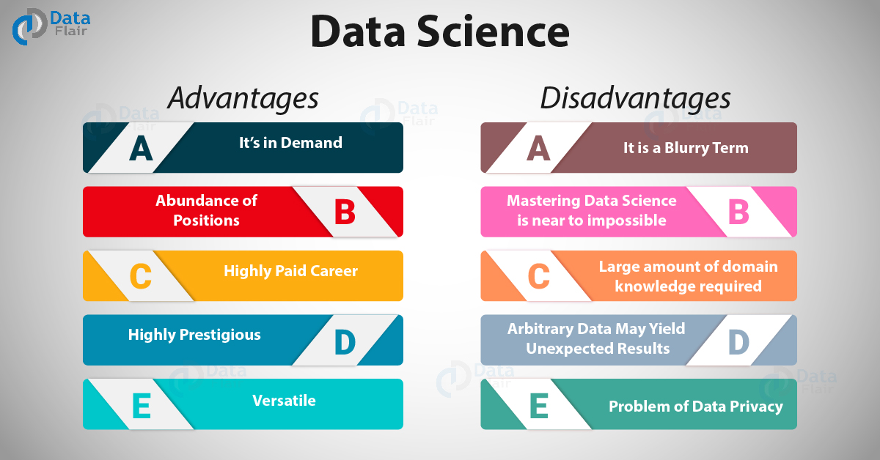
.

Slide 36
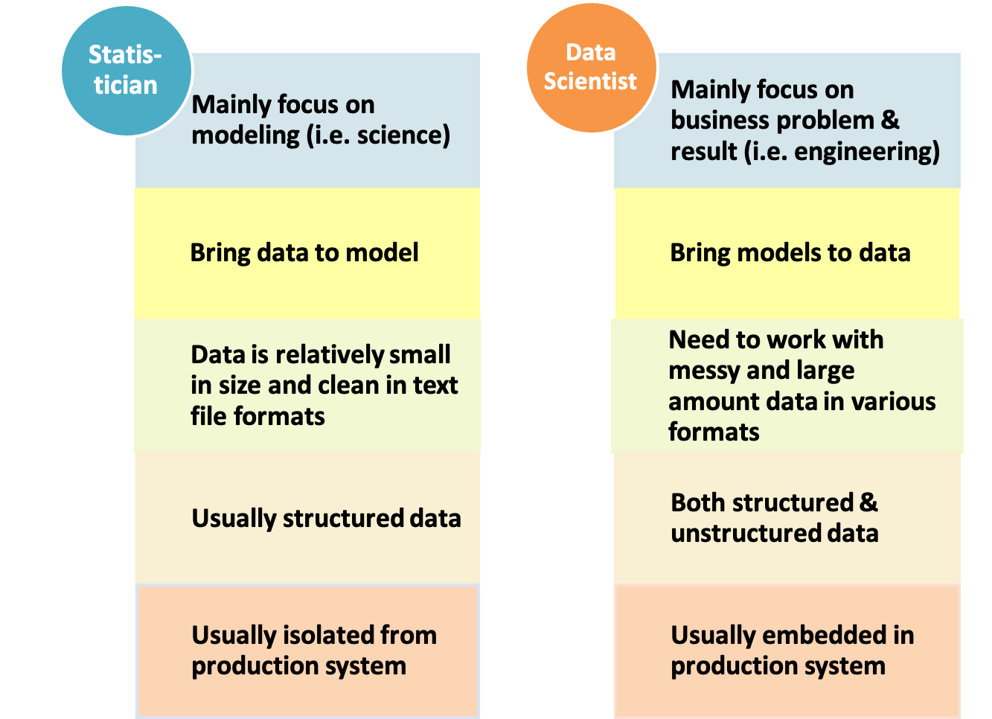
Statistics and Data Science
.

Slide 37
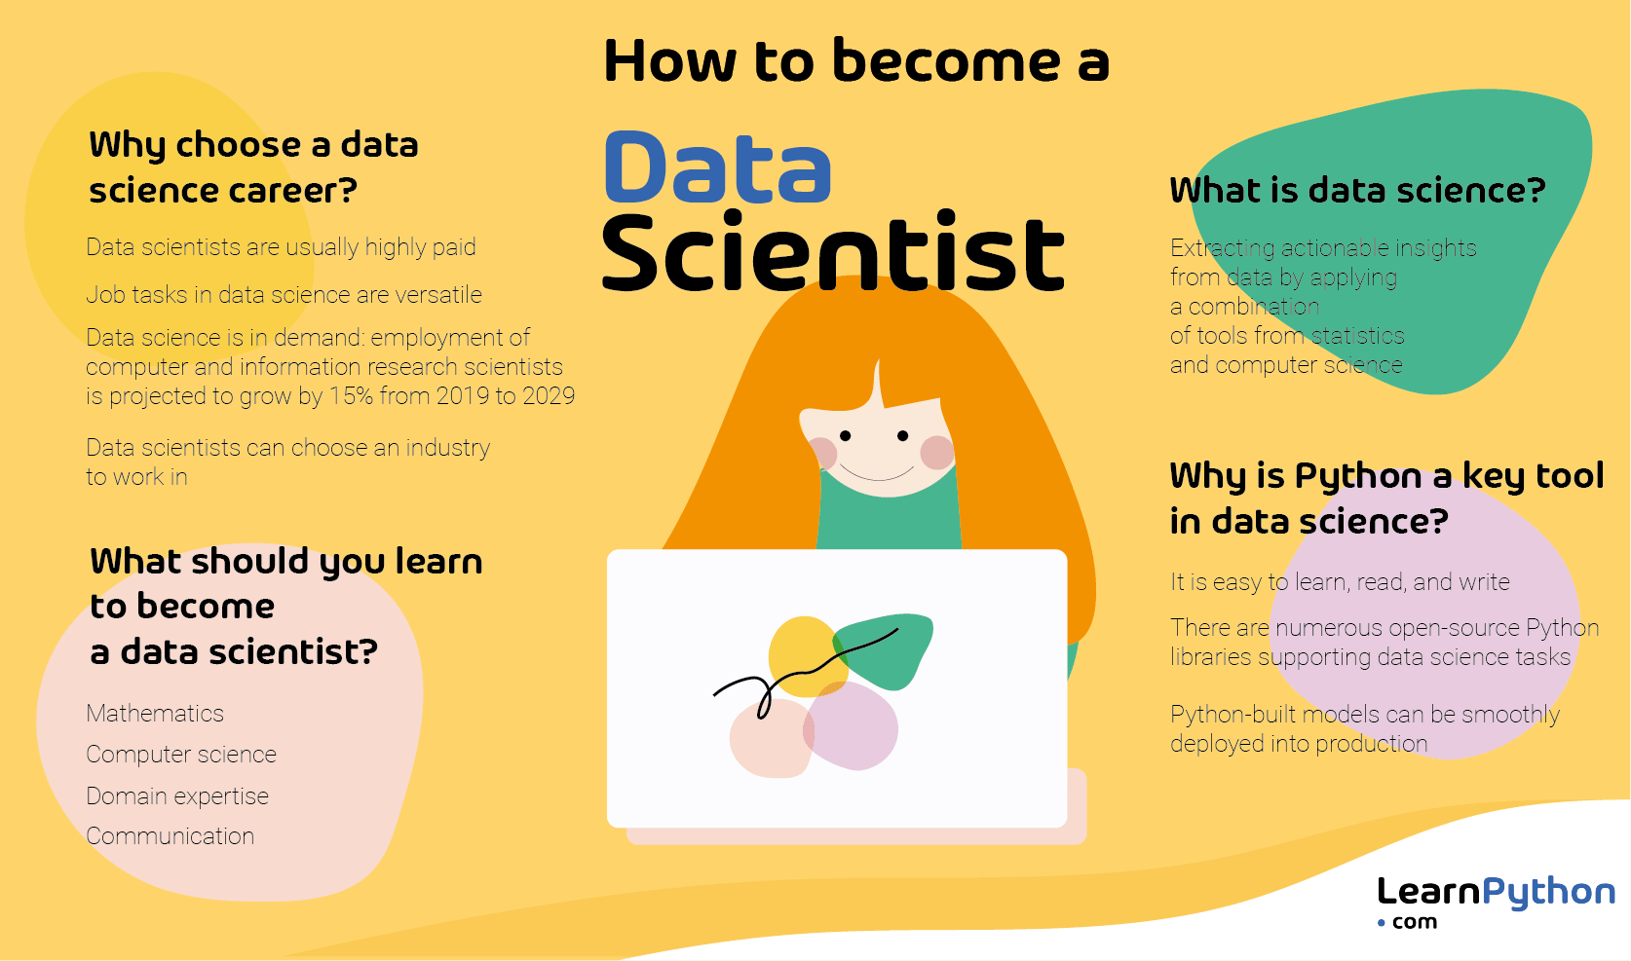
.

Slide 38
Thank You

